Slide 1

Comparing Two Regression Lines
Reading: 3.3
exercises: Ch 3. 30,31,48
Assigned: hw 8
Producer: dr. mario
img credit: alex riegert-waters

Slide 2
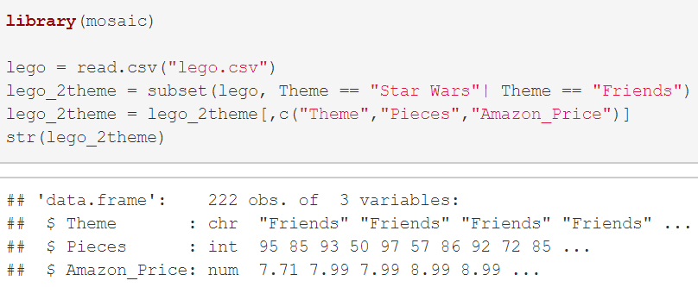
Example: Lego Sets
Goal: We want to use a linear regression model to predict the Amazon price of a Lego set based off the theme.

Slide 3
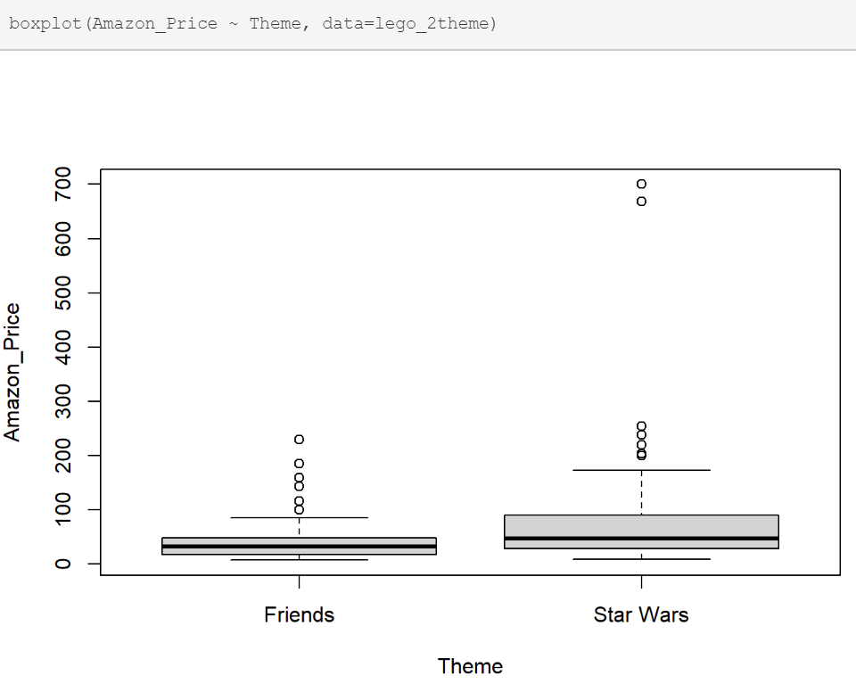
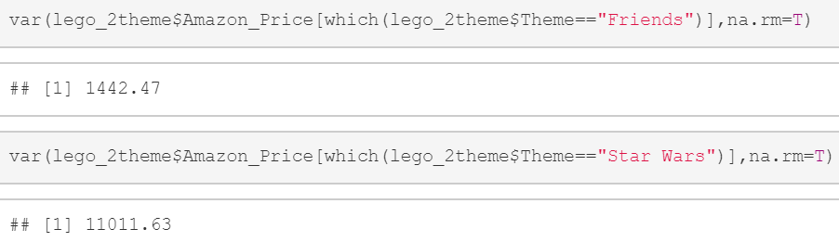


Example: Lego Sets
Use Classic t-Test for Difference in Population Means
Assume Variance of Amazon Price of Both Groups are Equal
$$μ_{1}=Average Price of Friends Theme$$
$$μ_{2}=Average Price of Star Wars Theme$$
Seems Like a Bad Assumption

Slide 4
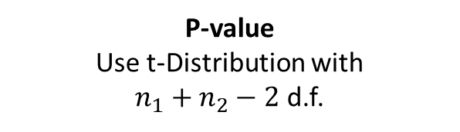

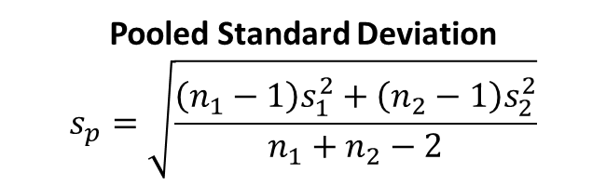

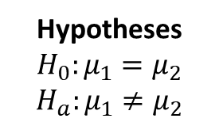

Review of Pooled t-Test
Use Classic t-Test for Difference in Population Means
Pooled t-Test (Assuming Variances are Equal)
$$μ_{1}=Average Price of Friends Theme$$
$$μ_{2}=Average Price of Star Wars Theme$$
Hypotheses
$$H_{0}:μ_{1}=μ_{2}$$
$$H_{a}:μ_{1}≠μ_{2}$$
Test Statistic
$$t^{∗}= \frac{{\overline{y}}_{1}−{\overline{y}}_{2}}{s_{p}\sqrt{1/{n_{1}}+1/{n_{2}}}}$$
P-value
Use t-Distribution with
$n_{1}+n_{2}−2$ d.f.
Pooled Standard Deviation
$$s_{p}=\sqrt{\frac{\left(n_{1}−1\right)s_{1}^{2}+\left(n_{2}−1\right)s_{2}^{2}}{n_{1}+n_{2}−2}}$$

Slide 5
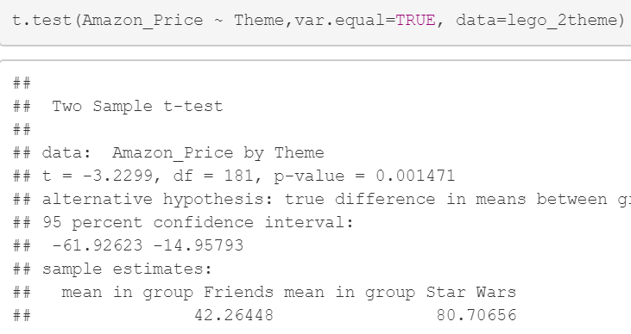
Example: Lego Sets
Results from Pooled t-Test

Slide 6
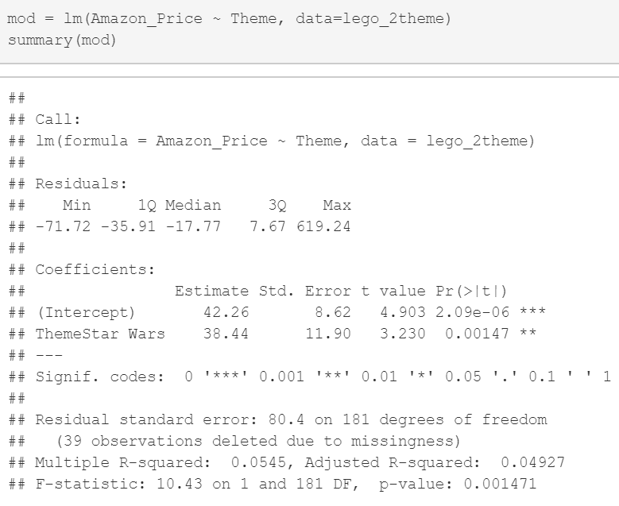
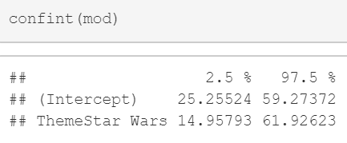
Example: Lego Sets
Results from Linear Regression
Equivalent Results Because of the Homoscedastic Assumption in Linear Regression

Slide 7

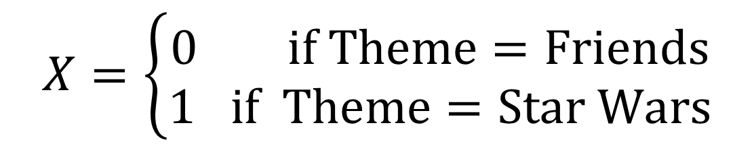
Indicator Variables
We Cannot Fit the Model Below if X is Categorical
We Must Recode X to be Numeric
Recoding X as an Indicator Variable (Dummy Variable)
$$Y=β_{0}+β_{1}X+ε$$
$$X=\left\{\begin{aligned}0 if Theme=Friends \\ 1 if Theme=Star Wars\end{aligned}\right.$$

Slide 8
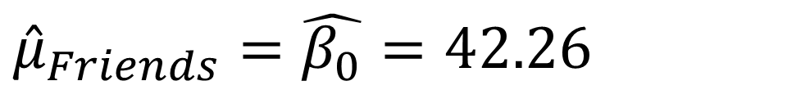
Indicator Variables
Linear Regression Model is Two Horizontal Lines or Two Dots
Slope is the Change in Predicted Y if We Switch from X = 0 to X=1
t-Test: If the indicator variable X is not significant, then we don’t have evidence that there is a difference in the average amazon price between the two themes Friends and Star Wars.
$${\hat{μ}}_{Friends}=\hat{β_{0}}=42.26$$
$${\hat{μ}}_{Star Wars}=\hat{β_{0}}+\hat{β_{1}}=42.26+38.44=80.7$$

Slide 9

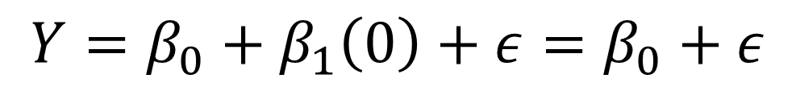
Indicator Variables
The Two Models Have the Same Error Term
Standard Error of the Regression is the Estimated Standard Deviation of that Error Term
Homoscedasticity Assumption for Lego Model Led to ${\hat{σ}}_{ε}=80.4$
$$Y=β_{0}+β_{1}\left(0\right)+ε=β_{0}+ε$$
$$Y=β_{0}+β_{1}\left(1\right)+ε=(β_{0}+β_{1})+ε$$

Slide 10
Indicator Variables
Confidence Intervals
CI for Intercept Represents Where We Believe the Average of Y to be for the Group Recoded as 0
CI for Slope Represents What We Believe the Difference to be Between the Average Y for Group 1 and Average Y for Group 0

Slide 11
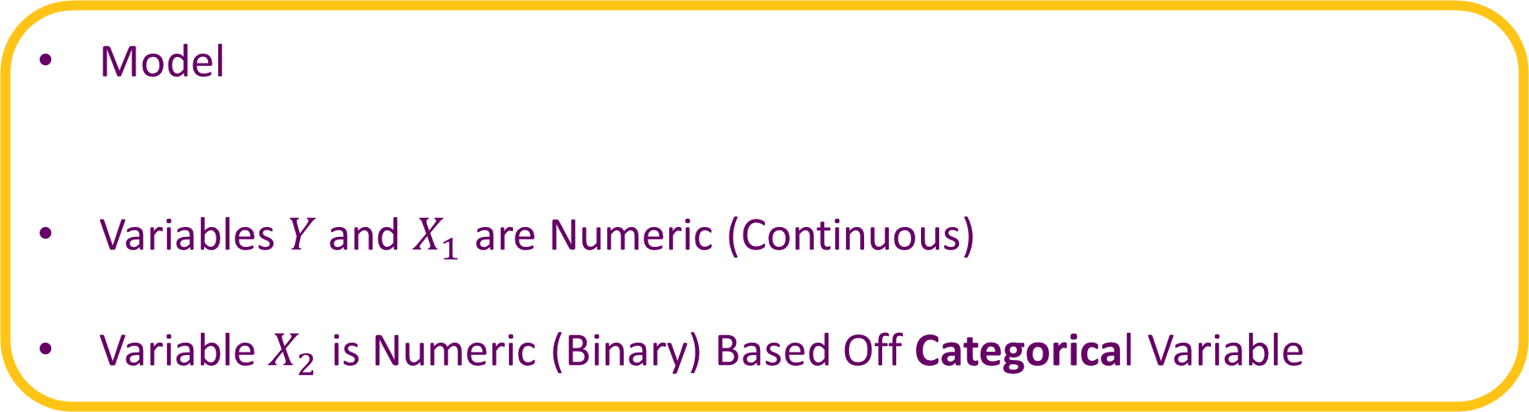
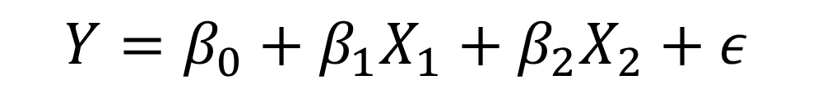
Linear Regression with Indicator
Model
Variables $Y$and $X_{1}$ are Numeric (Continuous)
Variable $X_{2}$ is Numeric (Binary) Based Off Categorical Variable
$$Y=β_{0}+β_{1}X_{1}+β_{2}X_{2}+ε$$

Slide 12
Linear Regression with Indicator
Parallel Lines
Same Slopes But Different Y-Intercepts
$$Y=β_{0}+β_{1}X_{1}+β_{2}\left(0\right)+ε=β_{0}+β_{1}X_{1}+ε$$
$$Y=β_{0}+β_{1}X_{1}+β_{2}\left(1\right)+ε={(β}_{0}+β_{2})+β_{1}X_{1}+ε$$

Slide 13
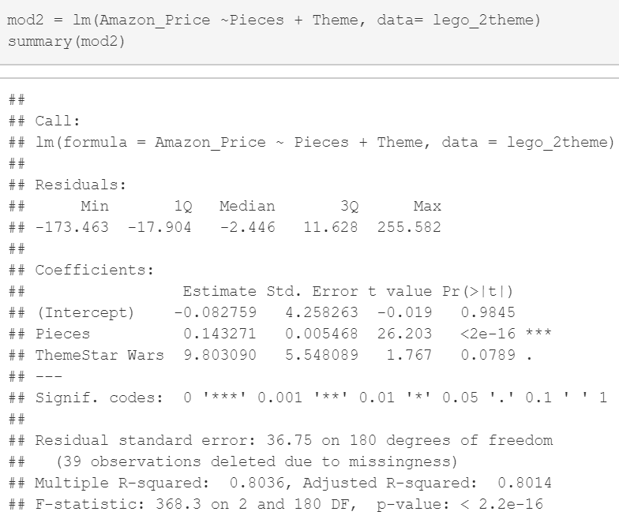
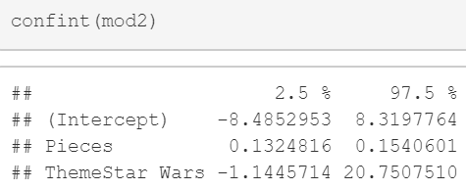
Example: Lego Sets
What Did We Learn About Theme?

Slide 14
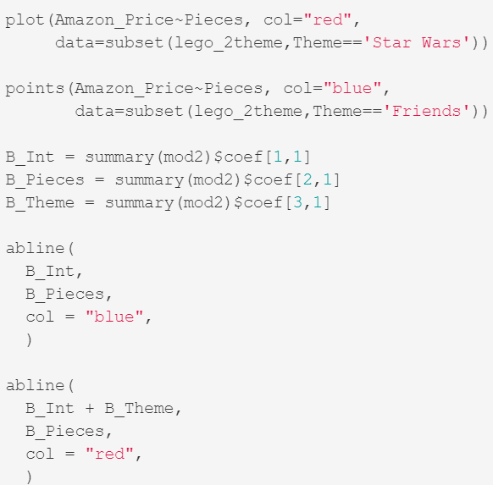
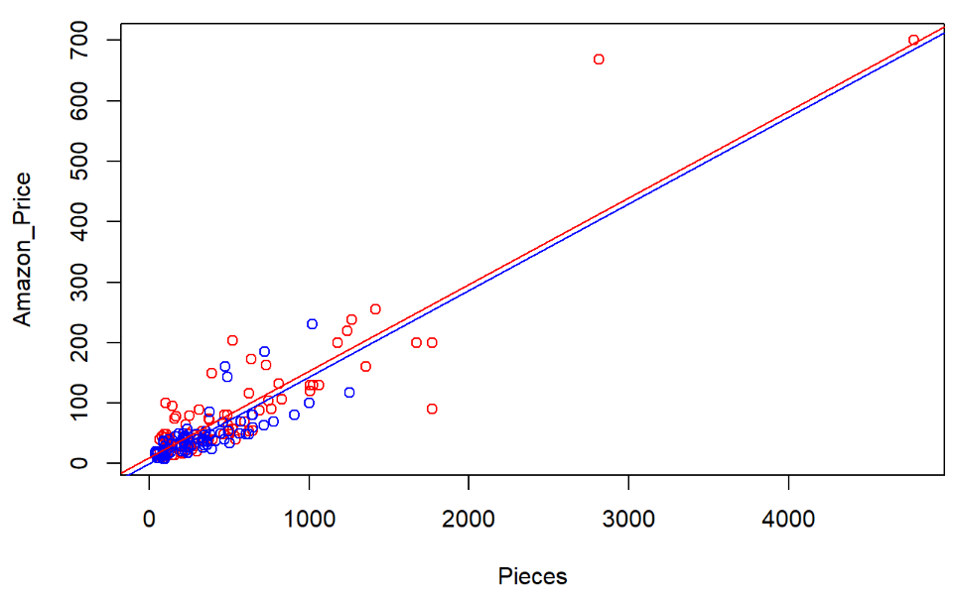
Example: Lego Sets
Are You Surprised?

Slide 15
Linear Regression with Indicator
Model with Interaction Variable
Not Parallel Lines and Still Same Error Term (Homoscedasticity)
Model for Group 0
Model for Group 1
$$Y=β_{0}+β_{1}X_{1}+β_{2}X_{2}+β_{3}(X_{1}X_{2})+ε$$
$$Y=β_{0}+β_{1}X_{1}+ε$$
$$Y={(β}_{0}+β_{2})+{(β}_{1}+β_{3})X_{1}+ε$$

Slide 16
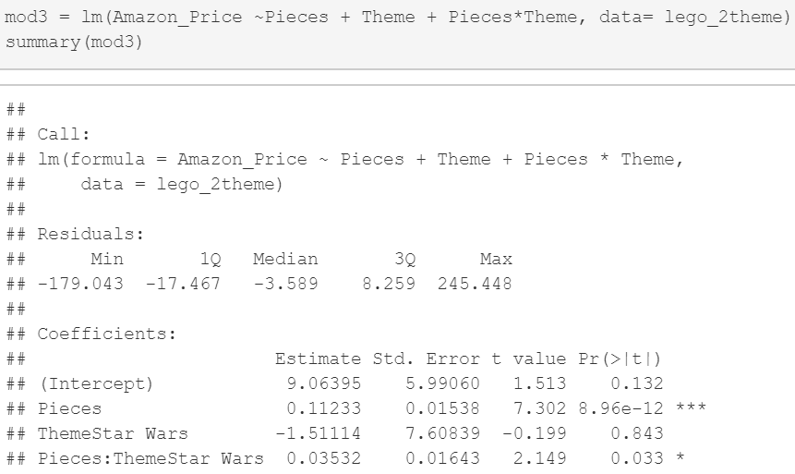
Example: Lego Sets
If an Interaction Variable is Significant, Don’t Remove the Individual Variables No Matter if They are Significant

Slide 17
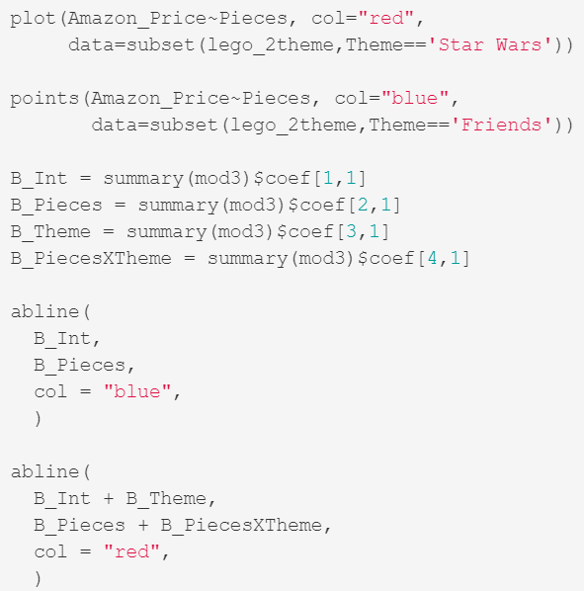
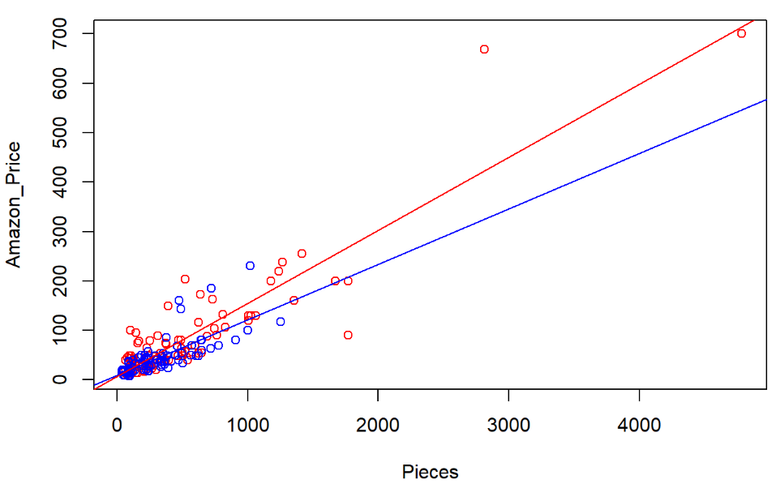
Example: Lego Sets
Lines Have Different Slopes and Intercepts

Slide 18
Conclusion
Textbook Splits Dataset Into Two Groups and Fits Separate Regression Lines to Each of the Groups
What is Better?
Two Separate Models Fitted to Two Separate Datasets
One Model with Interaction Fitted to Full Dataset
Read Textbook to See Checking of Assumptions From Residuals

Slide 19
Thank You
Make Reasonable Decisions

